Slide 1
MINOR PROJECT
OBJECT DETECTION USING MACHINE LANGUAGE
Session 2018-19

Slide 2
INTRODUCTION
Efficient and accurate object detection has been an important topic in the advancement of computer vision systems. With the advent of machine learning technique the accuracy for object detection has increased significantly. The project aims to incorporate machine learning technique for detecting the object with the aim of providing high accuracy along with real time.
we present a novel approach to measure similarity and dissimilarity between shapes and exploit it for object recognition. In our system we are taking different parameters of an object and check it with the trained data set. Our system divides the input into an S*S grid. Each grid will predict only one object. The object inside the grid box will be detected and recognized.

Slide 3
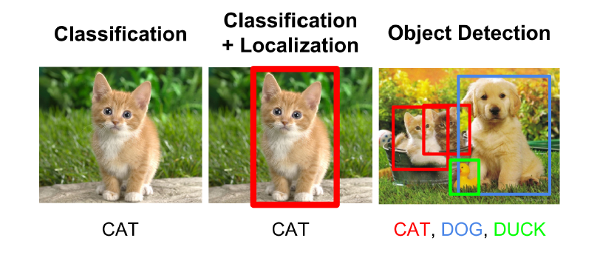
PROBLEM DEFINATION
Problem statement:
We humans have the ability to detect and identify any object in the spur of a moment whereas although the computers are fast and efficient yet they cant identify any object introduced in front of them. so here we are trying to detect and identify different objects in real time using machine learning which was a saturating problem a decade ago.
The input to the system will be a image, and the output will be a bounding box corresponding to all the objects in the image, along with the class of object in each box. An overview of all these problems is depicted

Slide 4
Existing system-
In the existing system it can identify only a few things
In the existing system there is the saturation in computer vision technique.
There is the problem of image classification which is defined as predicting the class of the image.
Proposed system-
Here we are trying to get a high accuracy (mAP)
we are trying to identify object in real time

Slide 5
Minimum System requirement:
Hardware:
Processor – Intel dual core
4gb Ram
128 gb hard disk
Software:
OS-Windows 7,linux
Python 3
Numpy
Open Cv

Slide 6
Literature review
[1]Title: Shape Matching and Object Recognition Using Shape Contexts
Published in: IEEE Transactions on Pattern Analysis and Machine intelligence ( Volume: 24 , Issue: 4 , Apr 2002 ) Author(s) : Belongie, Serge ; Malik, Jitendra ; Puzicha Jan
This paper present a novel approach to measuring similarity between shapes and exploit it for object recognition. In our framework, the measurement of similarity is preceded by 1) solving for correspondences between points on the two shapes, 2) using the correspondences to estimate an aligning transform. In order to solve the correspondence problem, we attach a descriptor, the shape context, to each point. The shape context at a reference point captures the distribution of the remaining points relative to it, thus offering a globally discriminative characterization. Corresponding points on two similar shapes will have similar shape contexts, enabling us to solve for correspondences as an optimal assignment problem.

Slide 7
[2]Faster R-CNN: Towards Real-Time Object Detection with Region Proposal Networks
Published in: 2017 IEEE International Conference on Computer Vision (ICCV) author : Shaoqing Ren∗ Kaiming He Ross Girshick Jian Sun Microsoft Research {v-shren, kahe, rbg, jiansun}@microsoft.com
This paper present a conceptually simple, flexible, and general framework for object instance segmentation. Our approach efficiently detects objects in an image while simultaneously generating a high-quality segmentation mask for each instance. The method, called Mask R-CNN, extends Faster R-CNN by adding a branch for predicting an object mask in parallel with the existing branch for bounding box recognition. Mask R-CNN is simple to train and adds only a small overhead to Faster R-CNN, running at 5 fps. Moreover, Mask R-CNN is easy to generalize to other tasks

Slide 8
[3]You Only Look Once: Unified, Real-Time Object Detection
Published in: IEEE conference on computer vision & pattern recognition 770 778, Year of Publication-2012, Author: Joseph Redmon University of Washington, Santosh Divvala Allen Institute for Artificial Intelligence
This paper present YOLO, a new approach to object detection. Prior work on object detection repurposes classifiers to perform detection. Instead, we frame object detection as a regression problem to spatially separated bounding boxes and associated class probabilities. A single neural network predicts bounding boxes and class probabilities directly from full images in one evaluation. Since the whole detection pipeline is a single network, it can be optimized end-to-end directly on detection performance

Slide 9
[4] SSD: Single Shot MultiBox Detection
Published in: Computer vision and Pattern Recognition(cs.CV),IEEE (Submitted on 8 Dec 2015 (v1), last revised 29 Dec 2016 (this version, v5))) Author: Wei Liu, Dragomir Anguelov, Dumitru Erha, Christian Szeged, Scott Reed, Cheng-Yang Fu, Alexander C. Berg
We present a method for detecting objects in images using a single deep neural network. Our approach, named SSD, discretizes the output space of bounding boxes into a set of default boxes over different aspect ratios and scales per feature map location. At prediction time, the network generates scores for the presence of each object category in each default box and produces adjustments to the box to better match the object shape. Additionally, the network combines predictions from multiple feature maps with different resolutions to naturally handle objects of various sizes. Our SSD model is simple relative to methods that require object proposals because it completely eliminates proposal generation and subsequent pixel or feature resampling stage and encapsulates all computation in a single network

Slide 10
METHODOLOGY
Methodology:
As we know that videos are made up of subsequent images (frames) which are move fast enough. So that, human eyes realize them continuous. Now, for any processing on video we need to the frame. The video analysis is done by following
Image frame
Object Classification
Object Localization
Detect Object

Slide 11
Challenges
The major challenge in this problem is that of the variable dimension of the output which is caused due to the variable number of objects that can be present in any given input image. Any general machine learning task requires a fixed dimension of input and output for the model to be trained. Another important obstacle for widespread adoption of object detection systems is the requirement of real-time (>30fps) while being accurate in detection. The more complex the model is, the more time it requires for inference; and the less complex the model is, the less is the accuracy. This trade-o between accuracy and performance needs to be chosen as per the application

Slide 12
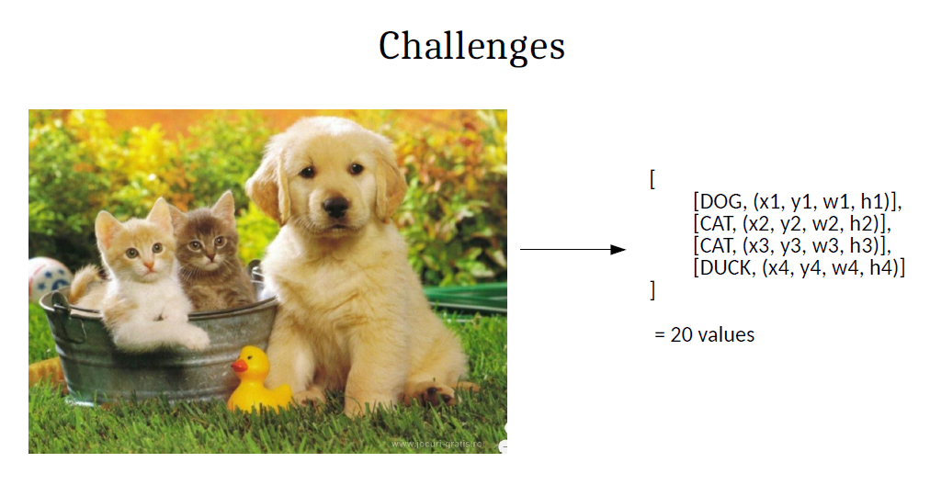
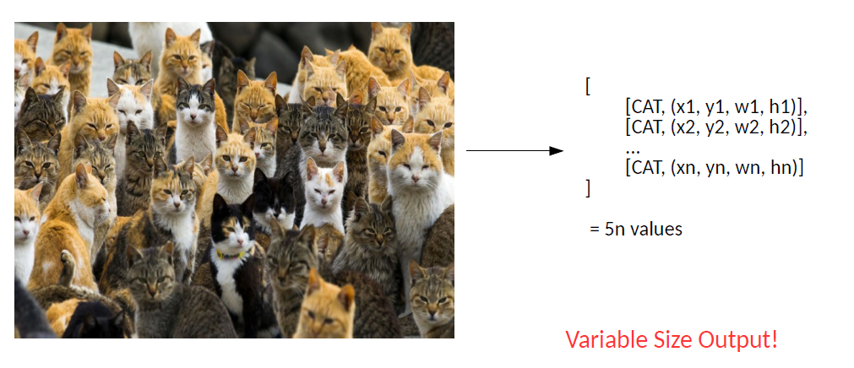

Slide 13
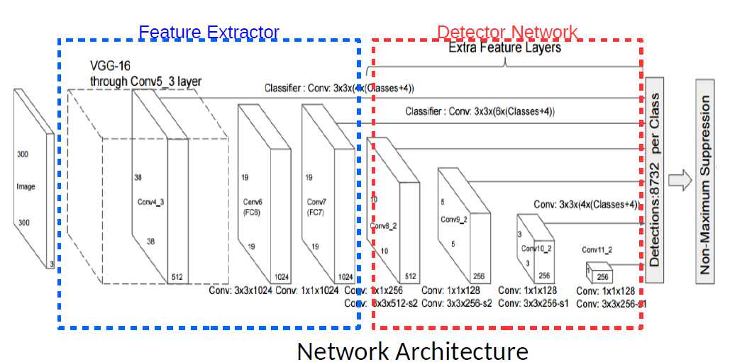
Methodology approach
Single shot detection(SSD )Object detection composes of 2 parts:
Extract feature maps, and
Apply convolution filters to detect objects
SSD uses VGG16 to extract feature maps. Then it detects objects using the Conv4_3 layer.

Slide 14
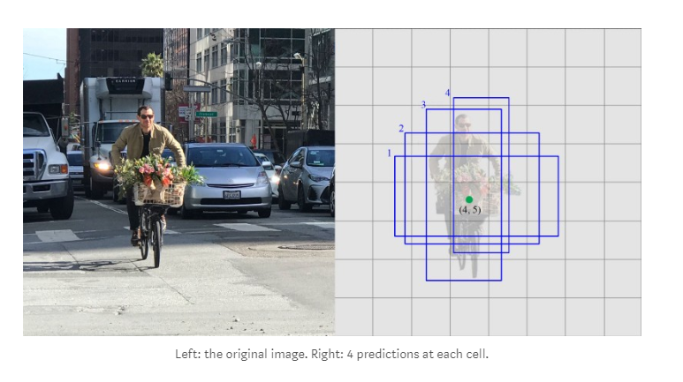
For illustration, we draw the Conv4_3 to be 8 × 8 spatially (it should be 38 × 38). For each cell (also called location), it makes 4 object predictions.

Slide 15
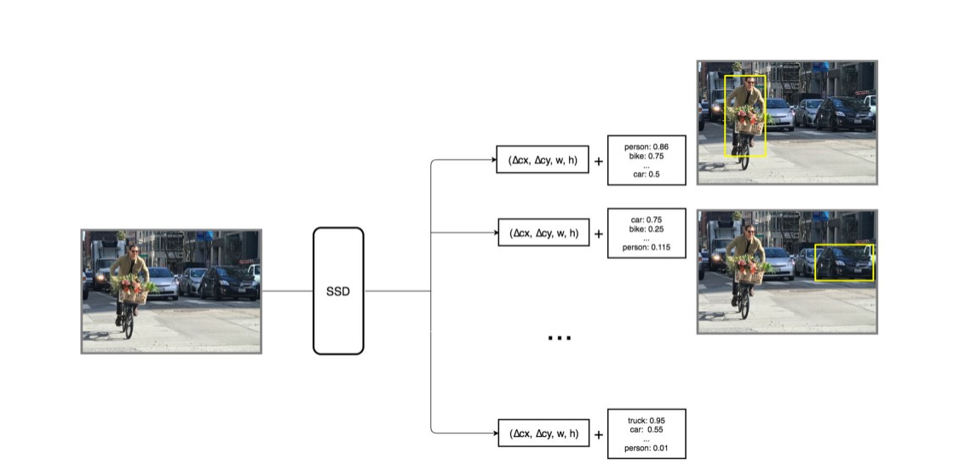
Each prediction includes a boundary box and 21 scores for 21 classes

Slide 16
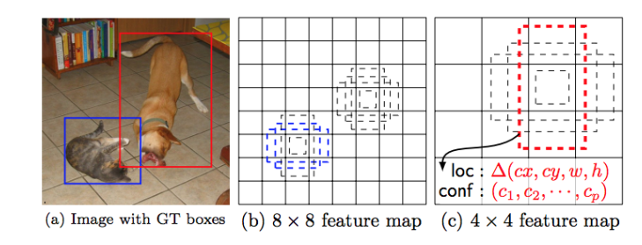
Multi-scale feature maps & default boundary boxes

Slide 17
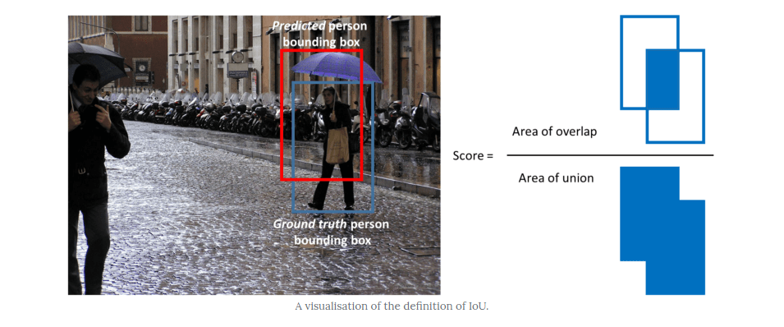
Evaluation metric
The most common evaluation metric that is used in object recognition tasks is ‘mAP’, which stands for ‘mean average precision’.
Each bounding box will have a score associated
Note that a detection is a true positive if it has an ‘intersection over union’ (IoU or overlap) with the ground-truth box greater than some threshold (usually 0.5). Instead of using mAP we typically use mAP@0.5 or mAP@0.25 to refer to the IoU that was used.

Slide 18
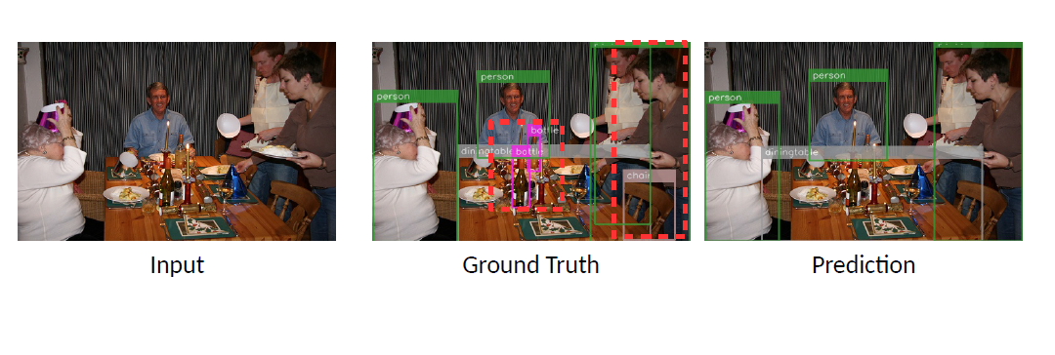
Ground truth & prediction

Slide 19
Data flow diagram
Level 0
user
Detection process
user
video
Localization
0.0

Slide 20
Level 1
Object validation
0.2
age
detect object
0.1
object localization
Capture image frame
Localized & validated object

Slide 21
Level 2
Input frame
SSD
Features Abstraction
Detector Network
0.1.1
0.1.1.1
0.1.1.2
Validate Object
Pre trained model
0.2.1
Detection
0.2.2

Slide 22
Use Case Diagram
Start Camera
Capture image frames
user
Pre processed data
SSD
system
classification
localization
Detection & output
Object Detection using machine learning

Slide 23
Gantt Chart:-

Slide 24
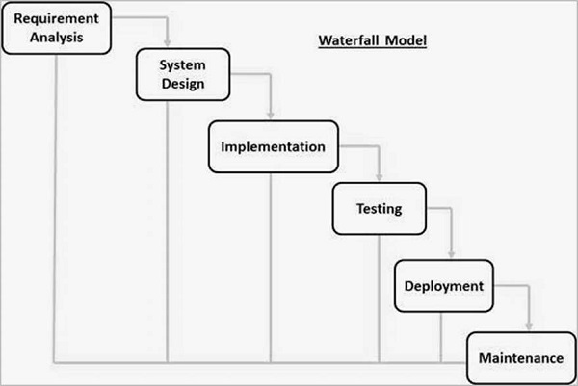
SDLC MODEL

Slide 25
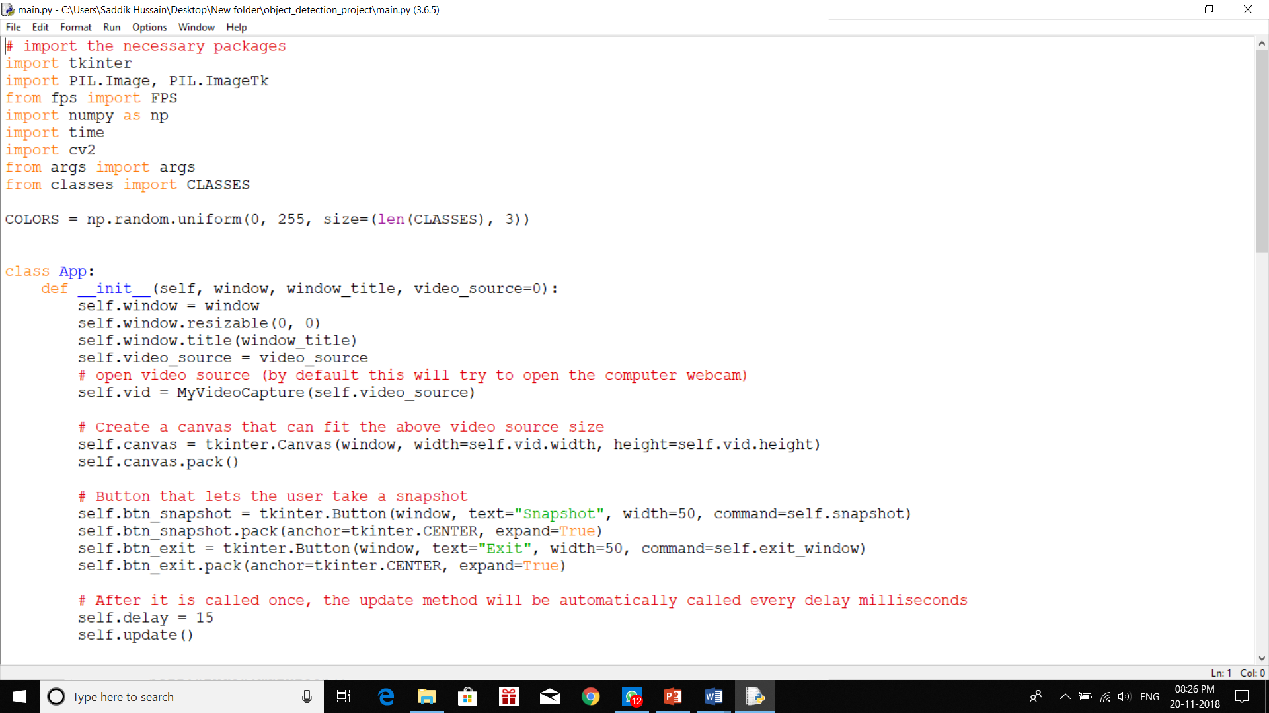
Implementation

Slide 26
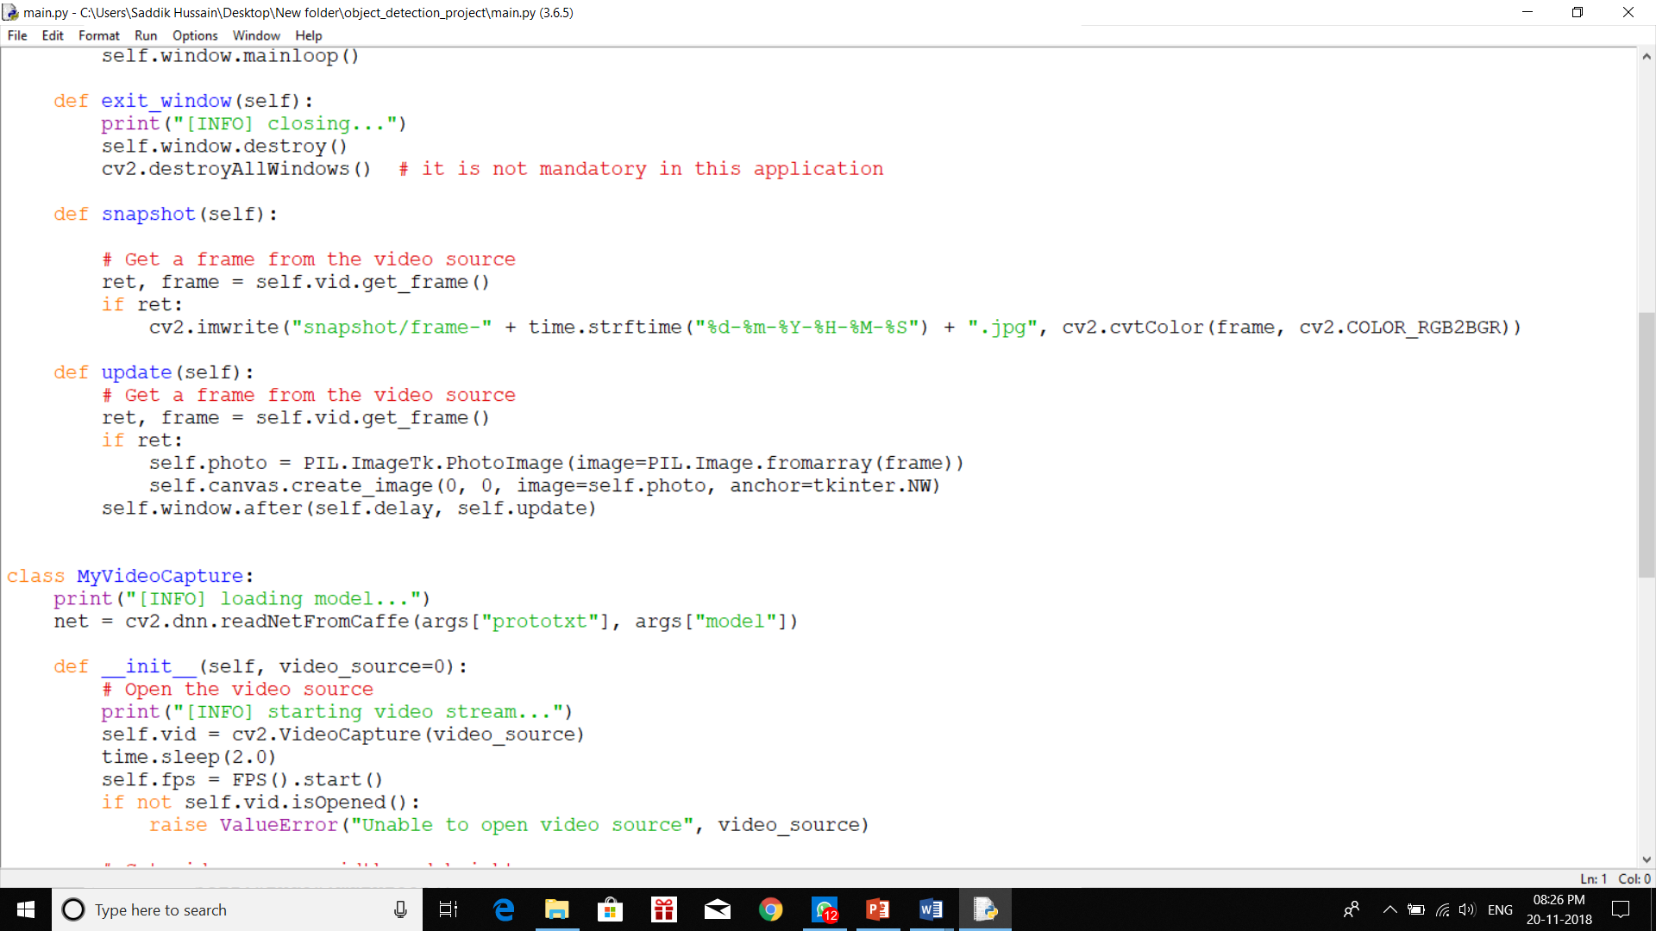

Slide 27
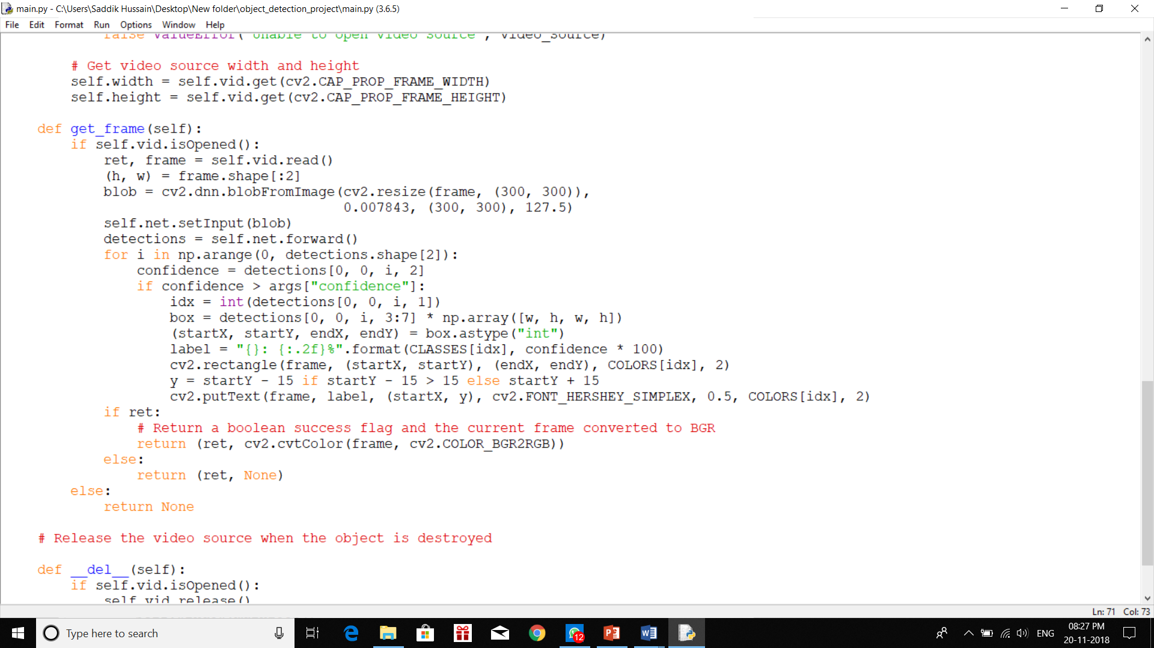

Slide 28
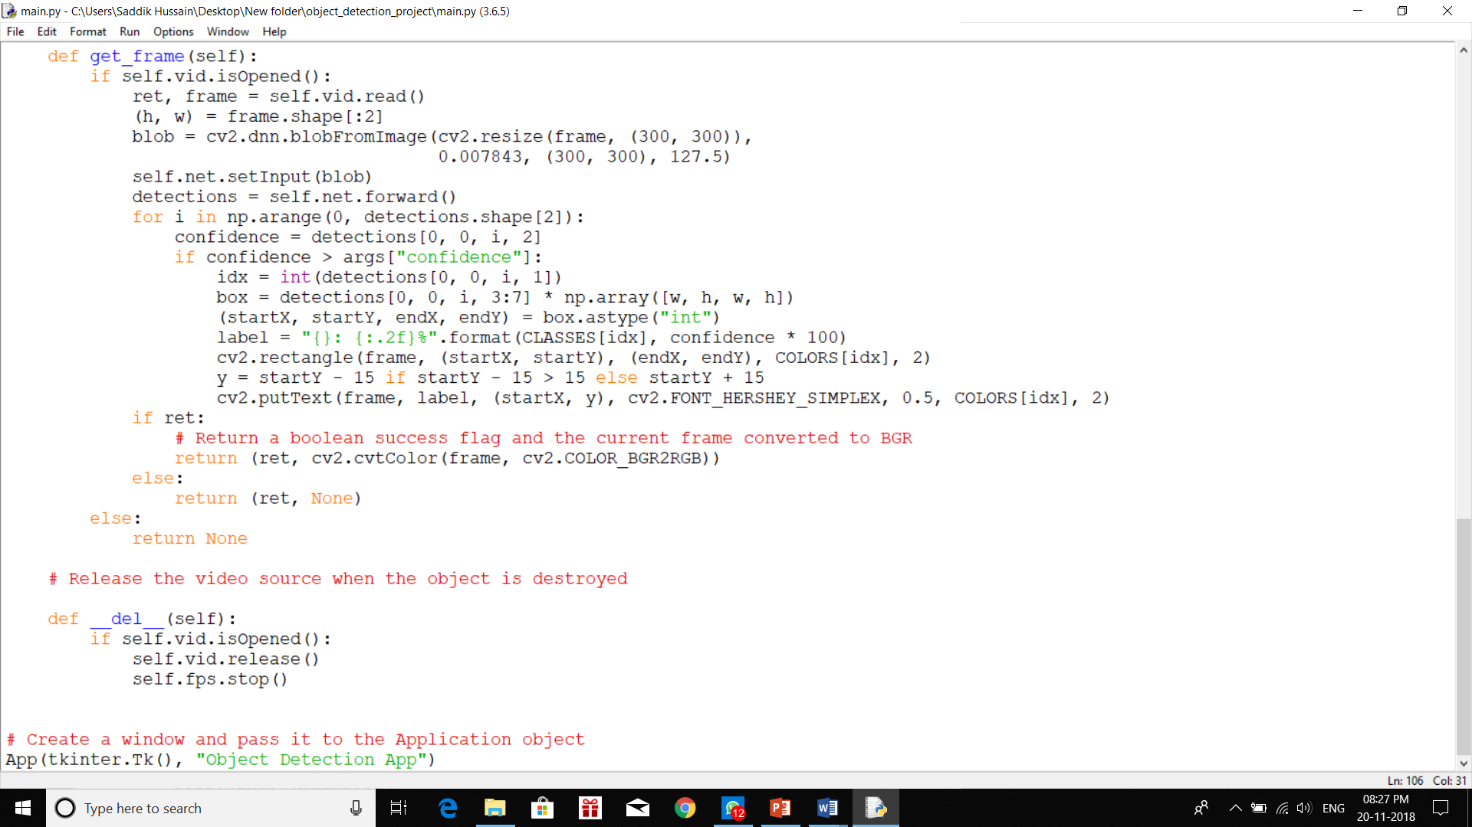

Slide 29

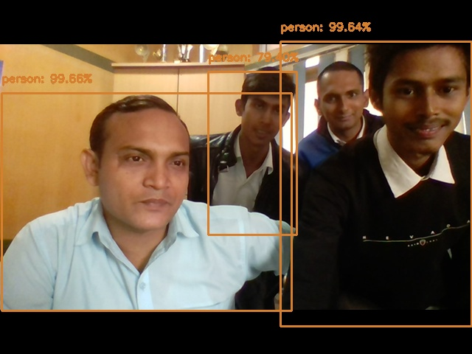


Slide 30
Conclusion:
We Presented an overview of the field of Object Detection, including historical developments, future potential, application areas, challenges, Components and requirements, state-of –arts systems, and UI concepts , SSD is an single shot dectector. It has no delegated region proposal networks and predicts the boundary boxes and the classes directly from feature maps in one single pass
Future enhancement
Image with relatively small size could be detected better, so smaller filters could be introduced
Detection of images under low light could be further improved.

Slide 31
REFERENCES:-
Shape Matching and Object Recognition Using Shape Contexts Published in: IEEE Transactions on Pattern Analysis and Machine intelligence ( Volume: 24 , Issue: 4 , Apr 2002 ) Author(s) : Belongie, Serge ; Malik, Jitendra ; Puzicha Jan
Faster R-CNN: Towards Real-Time Object Detection with Region Proposal Networks Published in: 2017 IEEE International Conference on Computer Vision (ICCV) author : Shaoqing Ren∗ Kaiming He Ross Girshick Jian Sun Microsoft Research {v-shren, kahe, rbg, jiansun}@microsoft.com
You Only Look Once: Unified, Real-Time Object Detection Published in: IEEE conference on computer vision & pattern recognition 770 778, Year of Publication-2012, Author: Joseph Redmon University of Washington, Santosh Divvala Allen Institute for Artificial Intelligence
SSD: Single Shot MultiBox Detection
Published in: Computer vision and Pattern Recognition(cs.CV),IEEE (Submitted on 8 Dec 2015 (v1), last revised 29 Dec 2016 (this version, v5))) Author: Wei Liu, Dragomir Anguelov, Dumitru Erha, Christian Szeged, Scott Reed, Cheng-Yang Fu, Alexander C. Berg

